Slide 1
H2V – a Haskell to Verilog Compiler
Reuben D'Netto
4th June 2014
Supervisors:
Lindsay Kleeman
David Boland
Notes:
Introduction
Who am I?
Purpose – explain what H2V is & why it's useful

Slide 2
Verilog
Applications
  Interfacing with digital integrated circuits
  Accelerating expensive computations
Notes:
Low-level hardware logic
Intrinsically parallel

Slide 3
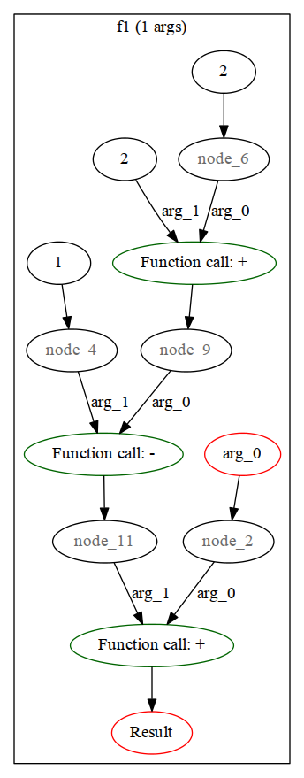
Haskell
f1 :: Int -> Int
f1 x = x + c where
a = 1
b = 2
c = d - a
d = b + 2
e = a + 2
Notes:
Pure functional language (no side effects)
Each value is described as a function of other values
Global variable = bottleneck
Lazy evaluation
Type signature, what 'pure functional language' means
Unused values are never called

Slide 4
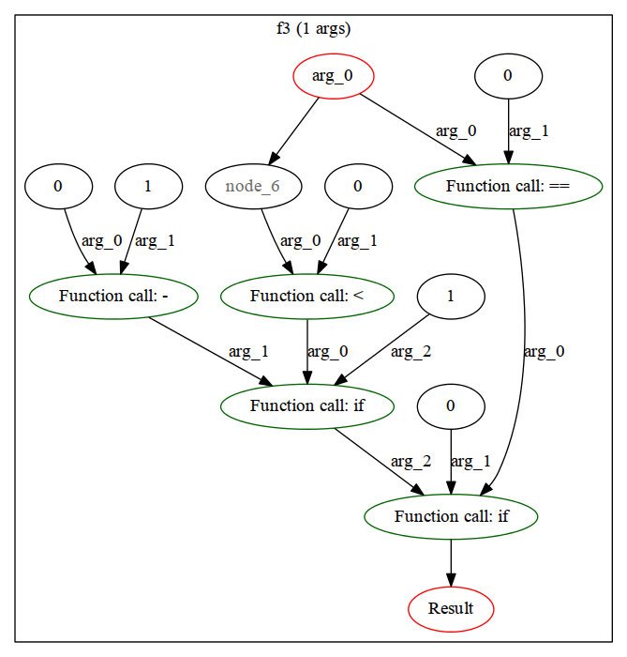
Haskell – Pattern Matching
f3 :: Int -> Int
f3 0 = 0
f3 x = if x < 0
then -1
else 1
Notes:
Don't spend more than a few seconds here.

Slide 5
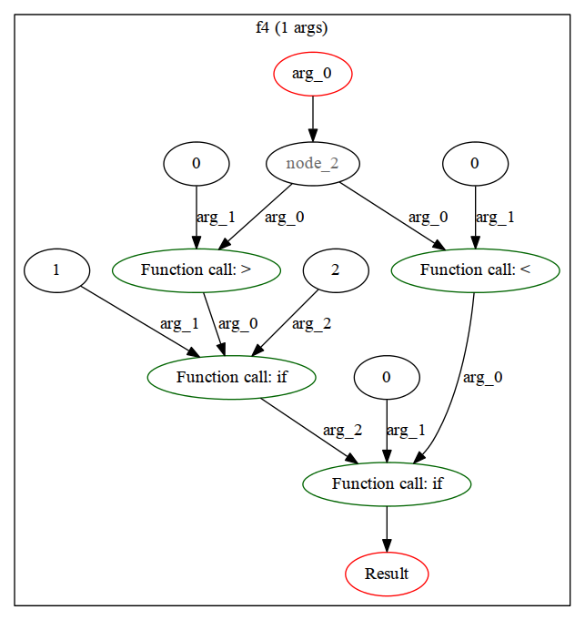
Haskell – Pattern Guards
f4 :: Int -> Int
f4 x
| x < 0 = 0
| x > 0 = 1
| otherwise = 2
Notes:
Don't spend more than a few seconds here.

Slide 6
Haskell – Pattern Guards cont.
module dfd_0(
//f4 (1 args)
input [7:0] node_1, //arg 0
output [7:0] node_0
);
wire [7:0] node_2;
wire [7:0] node_5;
wire [7:0] node_4;
wire [7:0] node_6;
wire [7:0] node_9;
wire [7:0] node_8;
wire [7:0] node_10;
wire [7:0] node_11;
wire [7:0] node_7;
wire [7:0] node_3;
assign node_2 = node_1;
assign node_5 = 0;
assign node_4 = node_2 < node_5;
assign node_6 = 0;
assign node_9 = 0;
assign node_8 = node_2 > node_9;
assign node_10 = 1;
assign node_11 = 2;
assign node_7 = node_8 ? node_10 : node_11;
assign node_3 = node_4 ? node_6 : node_7;
assign node_0 = node_3;
endmodule
Notes:
Jump straight to the next slide.

Slide 7
Haskell – Pattern Guards cont.
assign node_2 = node_1;
assign node_5 = 0;
assign node_4 = node_2 < node_5;
assign node_6 = 0;
assign node_9 = 0;
assign node_8 = node_2 > node_9;
assign node_10 = 1;
assign node_11 = 2;
assign node_7 = node_8 ? node_10 : node_11;
assign node_3 = node_4 ? node_6 : node_7;
assign node_0 = node_3;
Notes:
Brief discussion – just a demonstration that we are actually generating Verilog.

Slide 8
Haskell – Maps
xorArray :: Int -> [Int] -> [Int]
xorArray mask input = map (xor mask) input
int* xorArray(int mask, int* input, int* output, int N){
for(int i = 0; i < N; i++){
output[i] = input[i] ^ mask;
} //end for
return output;
}
Notes:
Mapping
Immutable variables

Slide 9
Limitations of C2H
Mutable variables create timing constraints
Sequential pipelines for iteration
All array/struct access occurs via single-port Avalon bus
Notes:
Most of these criticism apply equally to Vivado HLS & Handel-C – inherent problems with the use of C.
C2H starts by using many stages, than optimizes away those it can.
H2V starts with a bare minimum of stages, then adds what it needs to.
Better approach because we can balance stages better. e.g. 2 adds < 1 mult.

Slide 10
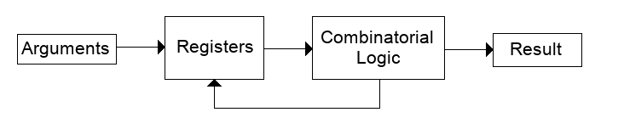
Recursion
Notes:
H2V supports tail-recursion
Constant space complexity
Registers store arguments (inputs), are overwritten each clock cycle

Slide 11
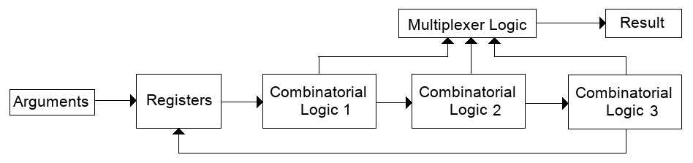
Recursion (loop unrolled)

Slide 12
Example – Recursive Function
-- Returns the nth fibonnacci number
fib :: Int -> Int
fib n = fib' 0 1 n
-- x0, x1 are accumulators, n counts down to the required index
fib' :: Int -> Int -> Int -> Int
fib' x0 _ 0 = x0
fib' x0 x1 n' = fib' x1 (x0 + x1) (n' - 1)
int fib(int n){
return _fib(0, 1, n);
}
int _fib(int x0, int x1, int n){
if(n == 0)
return x0;
else
return _fib(x1, (x0 + x1), (n - 1));
}

Slide 13
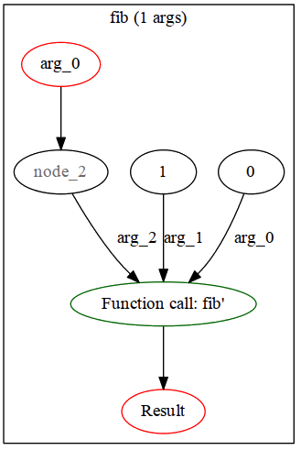
Example – Recursive Function

Slide 14
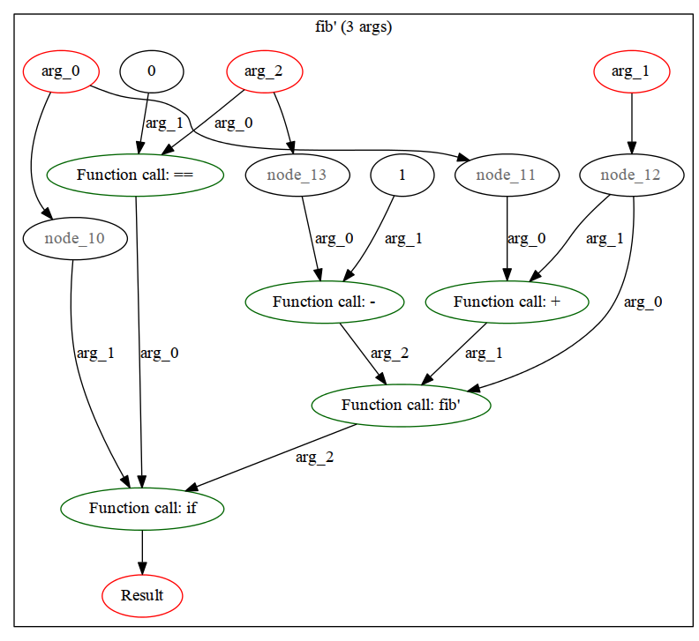
Example – Recursive Function
fib' x0 _ 0 = x0
fib' x0 x1 n = fib' x1 (x0 + x1) (n - 1)

Slide 15
Potential Applications
Signal & image processing
Linear algebra
Map-Reduce
Notes:
Signal & image processing – intrinsically parallel
Linear algebra = matrices
There are map reduce algorithms for sorting, matrix multiplication, etc.

Slide 16
Achievements to Date
Compilation Process
  Lexical Analysis & Parsing
  DFD Generation
    Pattern matching & guards
  Linking
  Verilog Generation
    Combinatorial
    Simple synchronous (tail-recursive) functions

Slide 17
Timeline for Semester 2
Week | Feature
1 | First-class functions
2
3 | Direct Memory Access
4
5
6 | List interface
7 | Qsys Integration
8 | Automatic Pipelining
9
10 | Benchmarks, Presentation
11
12

Slide 18
Conclusion
Notes:
Will outperform C2H
Improved parallelism

